Slide 1

Logistic Regression

Slide 2
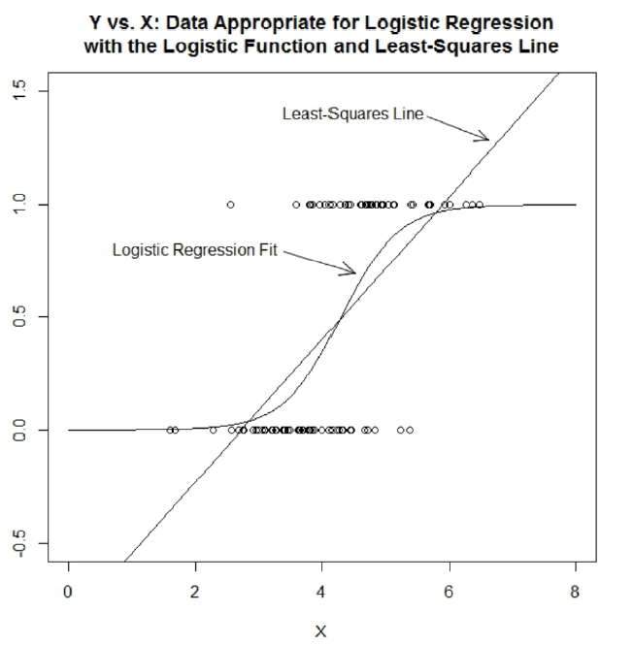
What is Logistic Regression
When you deal with a binary classification problem (The label only has 0 and 1), we can use logistic regression, because linear regression will no longer make sense (the errors are assumed to have a normal distribution).

Slide 3
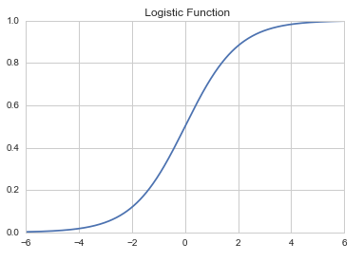


Mathematical Overview
Logistic Function: take an input from negative to positive infinity and it has always has an output between 0 and 1
Here t is a linear function with a variable x
Simply just substitute a basic linear function for t. We could then rewrite our logistic function equation as:

Slide 4
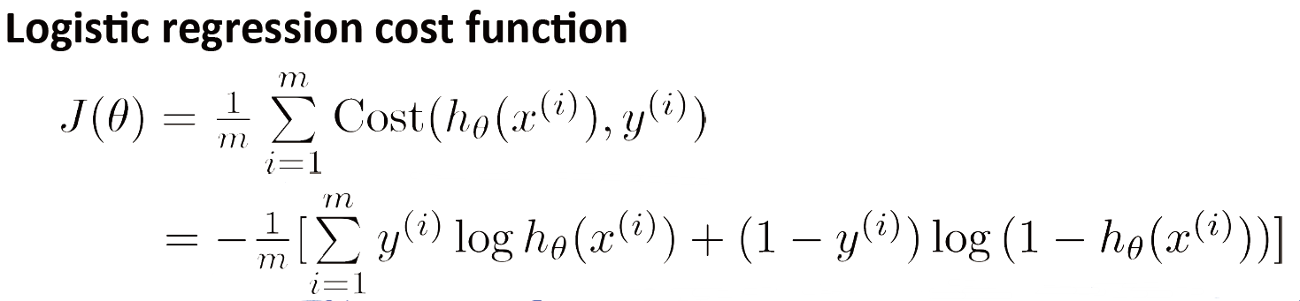
Cost Function

Slide 5

Demo of Logistic Regression

